Slide 1
IT Roles & Responsibilities
Sambathchatovong Na

Slide 2
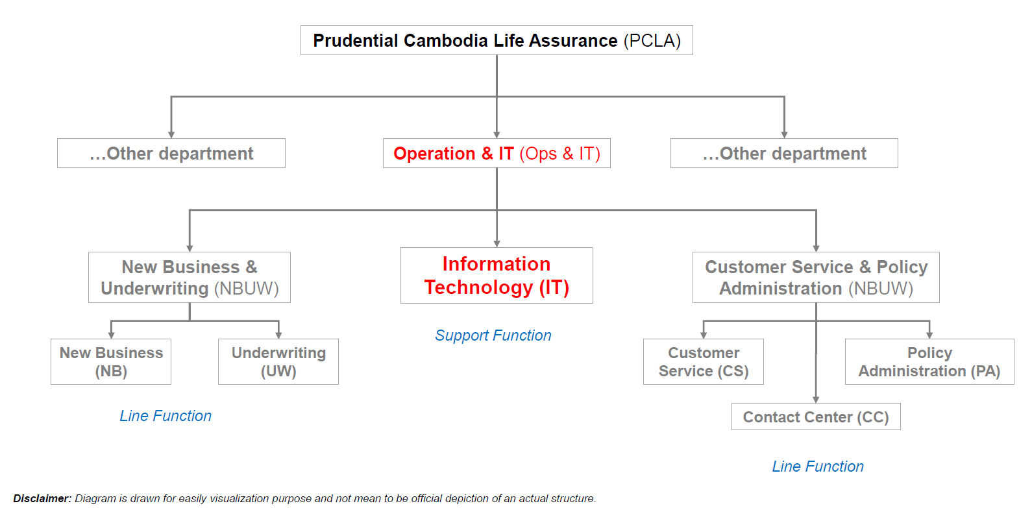
Where is IT in Prudential Cambodia?

Slide 3
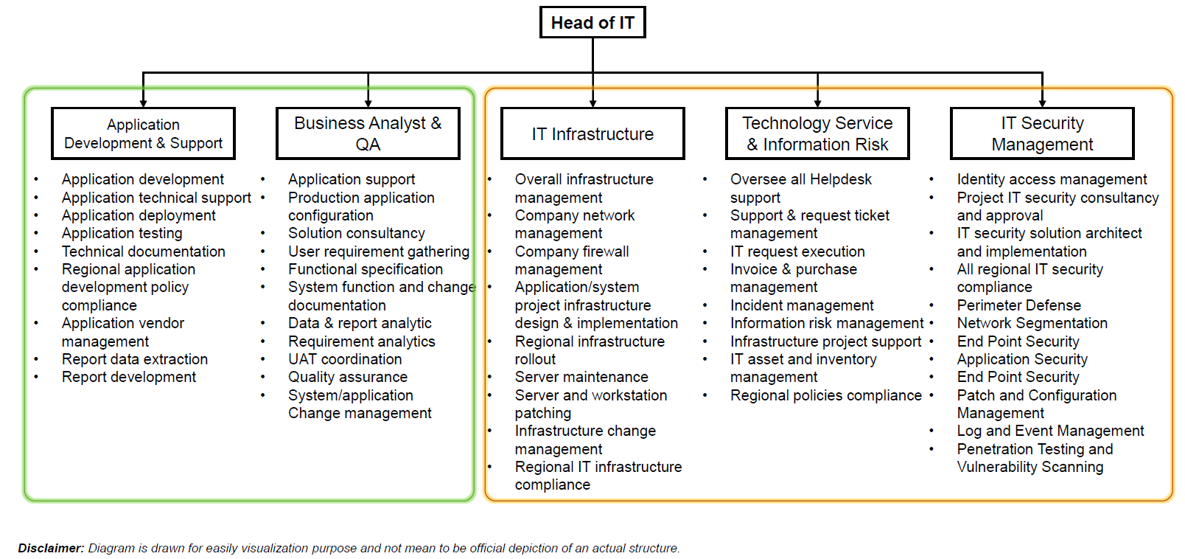
IT Function Operational Structure

Slide 4
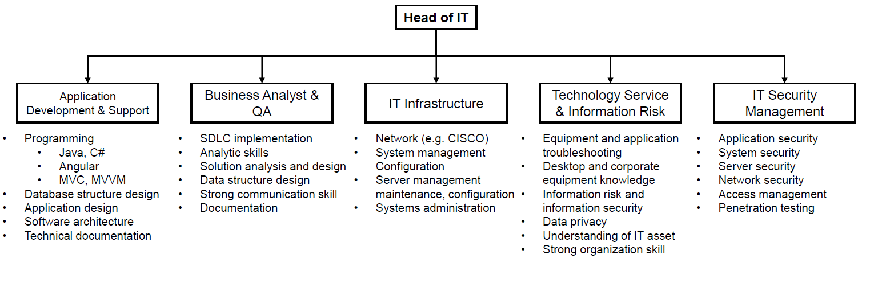
Skill Sets of Various Team

Slide 5
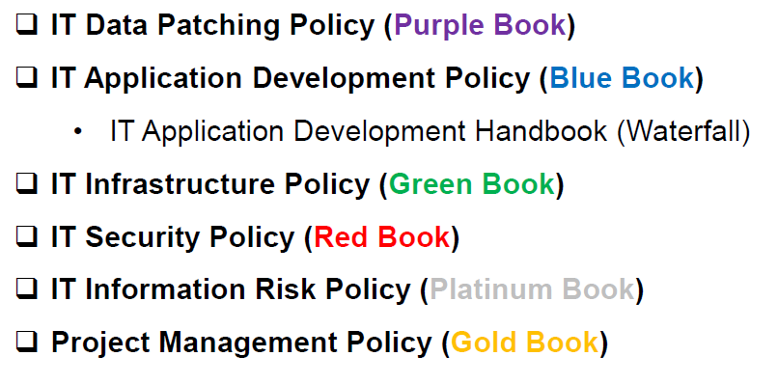
PCA IT Policies & Guidelines

Slide 6
THANK YOU

